Slide 1
Microservices with Spring Boot and Groovy
Andrew Rubalcaba

Slide 2
About Me
Developing in Java and Spring for past 10 years
Involved in local user groups
Twitter Handle: HAN_CHOLO
Email: a.rubalcaba@gmail.com

Slide 3
Agenda
Monolith Application Architecture
What is a Microservice?
Microservice Application Architecture
Microservice Communication
Microservices with Spring Boot + Groovy

Slide 4
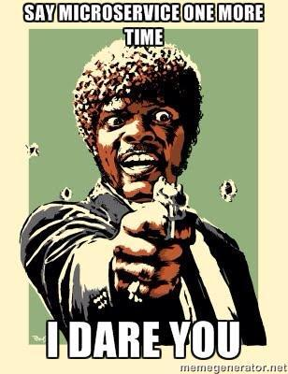

Slide 5
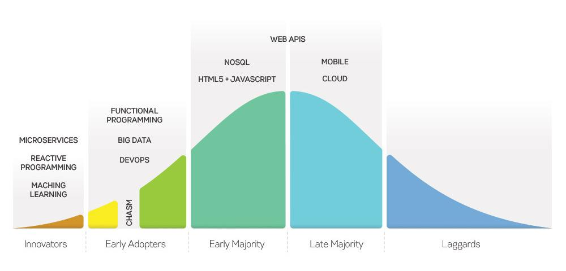

Slide 6
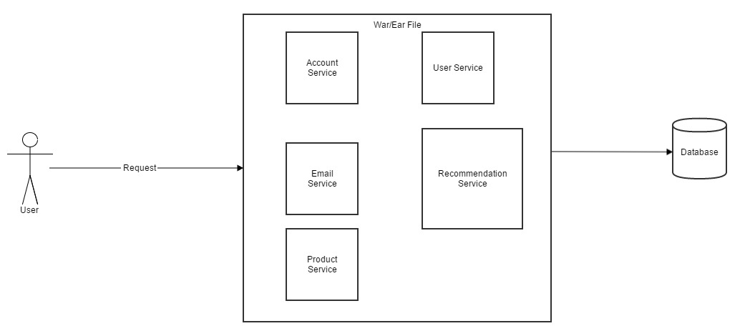
Monolithic Architecture

Slide 7
Pros
Easy to Develop
Easier to Test
Easier to Deploy

Slide 8
Cons
Bigger = Maintain Hell!
Frequent Deployment require Act of God
Harder to Adopt New Technology

Slide 9
Microservice
software architecture style, in which complex applications are composed of small, independent processes communicating with each other using language-agnostic APIs.
Loosely coupled service oriented architecture with bounded context

Slide 10
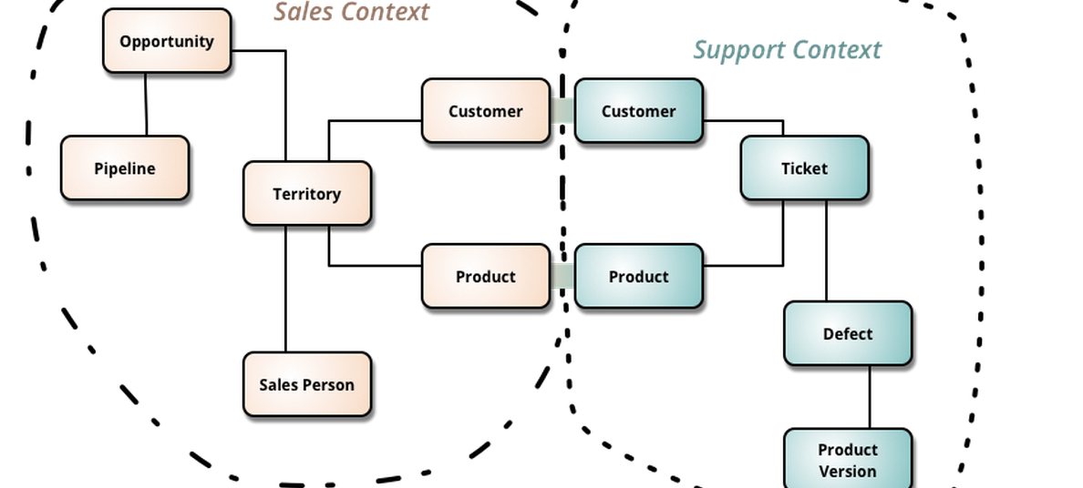

Slide 11
Single Responsibility Principle
Gather together those things that change for the same reason, and separate those things that change for different reasons – Uncle Bob

Slide 12
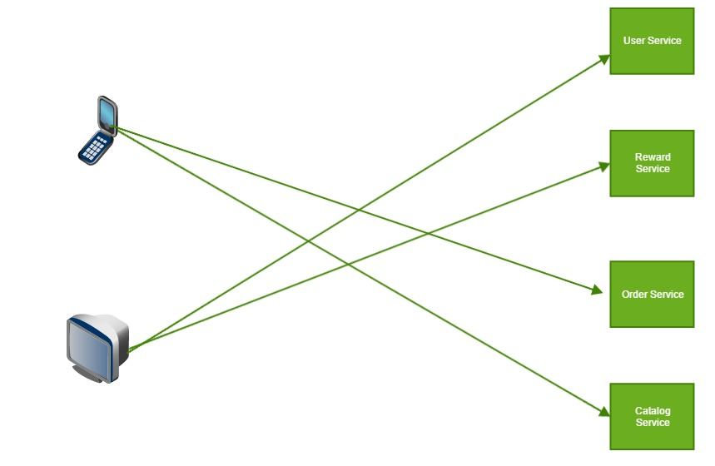
Microservice Archiecture

Slide 13
Pros
Less Code easier to understand
Deployed Independently
Scaled Independently
Scaled Development
Improves Fault isolation
Eliminates long-term commitment to technology stack

Slide 14
Cons
Complexity of Distributed Systems
Testing gets harder
Development Coordination becomes harder

Slide 15
Communication
Client 2 Application
Application 2 Application

Slide 16
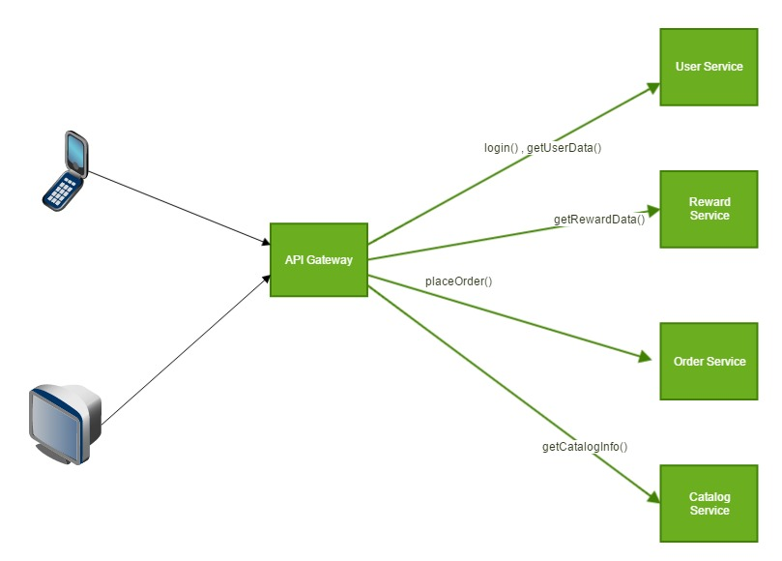
API Gateway Pattern

Slide 17
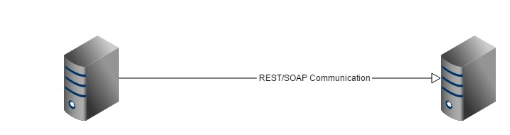
Inter-service Communication
HTTP(Rest or SOAP calls)

Slide 18
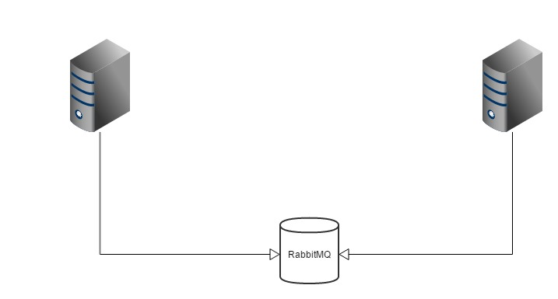
Inter-service Communication
Async Messaging like RabbitMQ or some other message broker

Slide 19
Spring Boot + Groovy

Slide 20
References
Code can be found here - https://github.com/arubalcaba/microservices-spring-boot-groovy
http://www.infoq.com/articles/microservices-intro
http://microservices.io/

